Slide 1
DevSecOps – Shifting security to the left

Slide 2
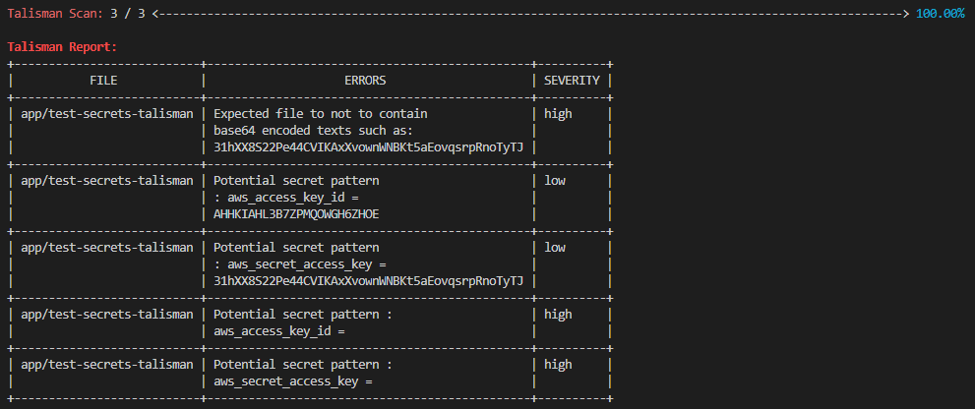
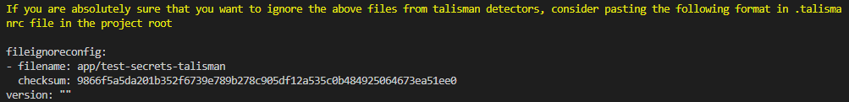
Pre-Push hooks
Install Talisman to our project – use as a prep-push hook, run on developer local.
Test Talisman
Created a file (test-secrets-talisman) with aws secrets and keys to test Talisman pre-push hooks.
Note: AWS secret and keys were edited to make them unusable. No other “known” sensitive information detected on the code. Below is related to test-secrets-talisman
Ignore the above file in Talisman. Create .talismanrc in root and add below.

Slide 3
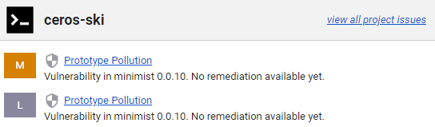
Software Composition Analysis – SCA
Software Composition Analysis (SCA) is an application security methodology for managing open source components (dependencies).
Tool Used: Synk
Jenkinsfile: Stage – ‘SCA – Synk’
Synk (Automated to fail on issues with severity=high and above.
Engage developers to research on dependencies
Can be install on Dev local to help fix issues before running pipeline.

Slide 4
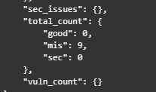
Static Application Security Analysis - SAST
SAST : analyzes source code to find security vulnerabilities that make applications susceptible to attack.
Tool Used: nodejsscan (other tools that can be used SonarQube, npm audit)
Jenkinsfile: Stage – SAST - nodejsscan
Engage developers to looking at missing security headers. 0 vulnerabilities detected, 9 missing_sec_header
Note: SonarQube was preferred tool as it has more capabilities but nodejsscan was used as it was easier to configure. SonarQube was giving hard time for this project.
See “nodejsscan-SAST-results” on root directory for more details.

Slide 5

Container Security – ECR and Trivy
The process of scanning containers and their components to identify potential security threats.
Jenkinsfile: Stage – Vulnerability Image Scan - Docker
Tools Used: Trivy
Node:15 scan results using trivy. ECR scan also enabled.
Tech Debt: Due to limited time I couldn’t find secure image. Node:alpine has zero vulnerabilities but fails on image build. Node:15 image was used for deployment.
This stage calls docker-image-scan.sh (root directory) to check for any CRITICAL vulnerability and fails if condition is true. Exit code = 1.

Slide 6
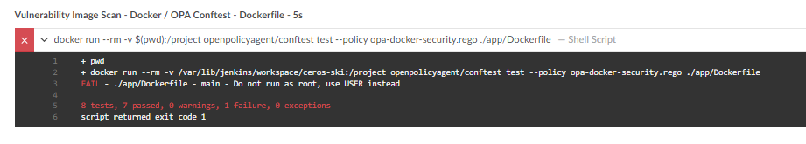
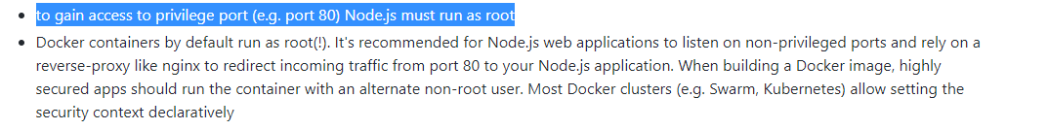
IaaC security test - Dockerfile
Scan for security misconfigurations on Docker files
Tool Used: OPA ConfTest
Jenkinsfile: Stage – ‘IaaC – Dockerfile’
Check Dockerfile against policies at opa-docker-security.rego (root directory)
Initially failed due to running Docker image as root. (7 out 8 tests passed)
Tech Debt - To gain access to privilege port (e.g. port 80) Node.js must run as root, this will be accepted.

Slide 7
IaaC security test - Terraform
Scan for security misconfigurations in Terraform files.
Tool Used: tfsec
Jenkinsfile: Stage – ‘IaaC- Terraform Scan’
Note: ALB ingress was fixed while testing Terraform deployments, this will not show on the report. See initial-terraform-tfscan-results file for detailed results

Slide 8
IaaC security test - Terraform
Response:
Issues | Severity | Resolutions | Risk Response
Ecs_load_balancer- egress allow anywhere | CRITICAL | IGNORE | Accept risk. The game is accessible anywhere.
Ecs_load_balancer – ingress fully open | CRITICAL | IGNORE | Accept risk. The game is accessible anywhere.
Aws_lb_listener.backend – uses HTTP instead of HTTPS | CRITICAL | Switch to HTTPS to benefit from TLS security feature | Accept risk – This is a test environment and no sensitive data(login) to access the game
Aws_iam_policy_document.ecs_agent- defines wildcard policy on resources(*) | HIGH | Specify exact permissions required, and to which resources they should apply instead of using wildcard | Accept risk. Actions on the resource are limited. Restrict to specific arn in production
Aws_ecr_repository not encrypted - | LOW | Use customer managed keys | Accept risk: Repo private(need to sign in)
Aws_ecs_cluster.cluster- ContainerInsight nt enable for observerbility and monitoring | LOW | Enable container insights | Accept Risk: This is a test environment, no need for monitoring
Aws_lb.ecs – does not drop invalid headers | HIGH | Set drop invalid headers to true | Accept risk –engage dev before setting this
Aws_lb.ecs is exposed publicly | HIGH | IGNORE | Accept risk. The game is accessible anywhere.
Aws_iam_policy_document – defines a policy with wildcard on actions (s3:*) | HIGH | Specify exact permissions required, and to which resources they should apply instead of using wildcard | Mitigate: No need for s3:* actions. Remove s3:*
Autoscaling group – fully open security group | CRITICAL | IGNORE | Accept Risk: This must accepted because of EC2 ACG dynamic node ports
Aws_lanch_configuration – unencrypted EBS | HIGH | Turn on encryptions for block devices | Accept risk – This is a test environment and not sensitive data(login) to access the game

